Slide 1
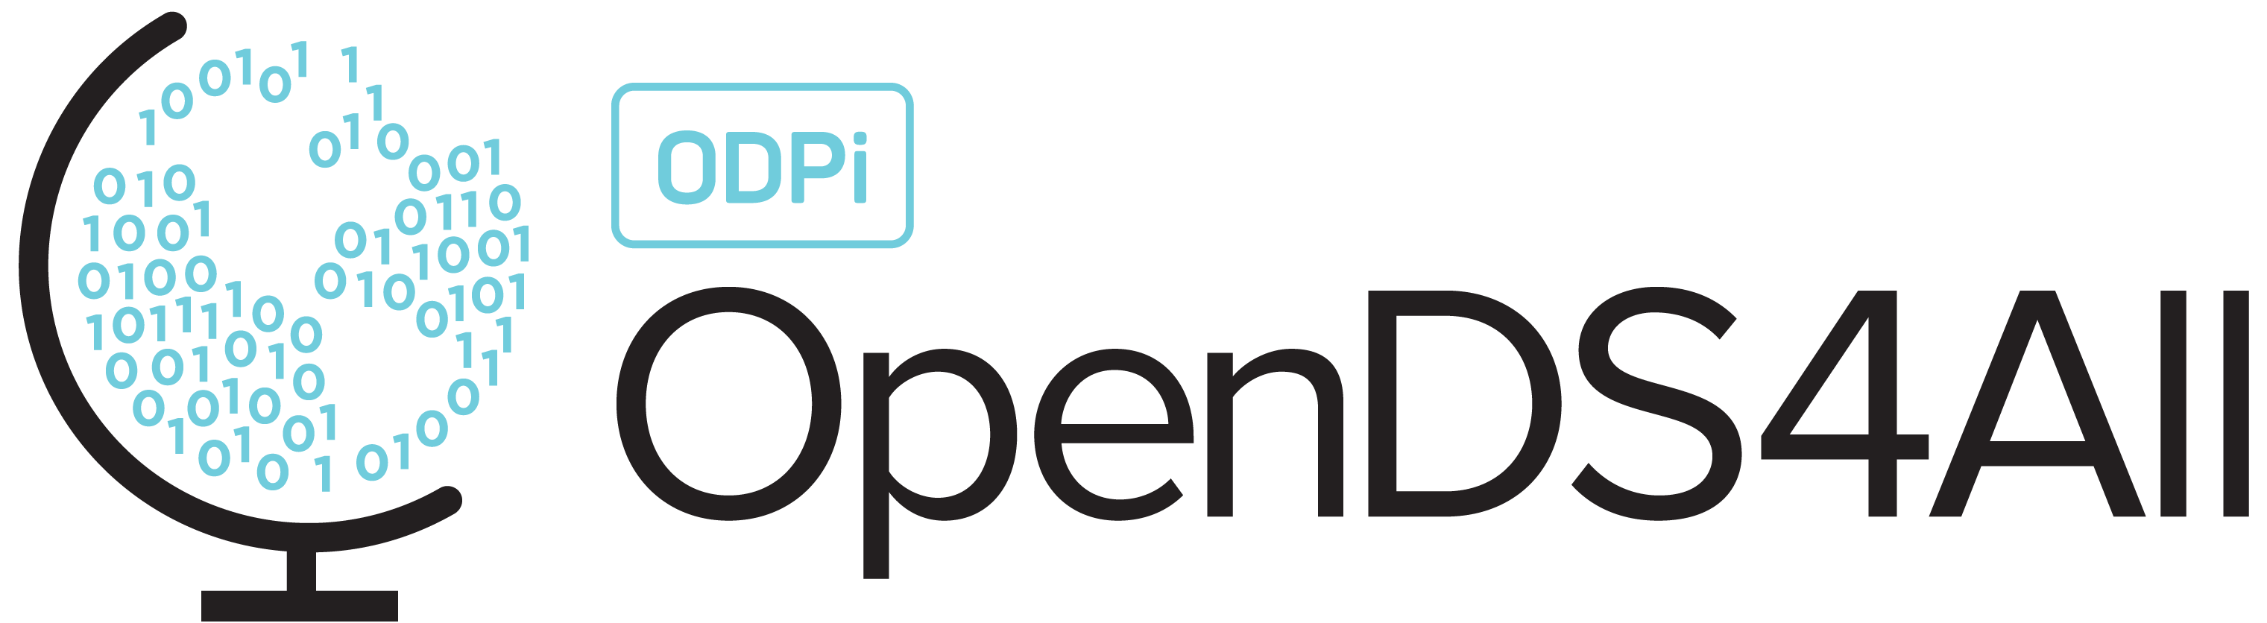
Data Science Ethics

Slide 2
Data Science Models Affect Every Aspect of Society
Admission to schools
Who to hire (and who to fire)
Work schedules
Who to date
Whether to grant a loan
What ads are shown, discounts are given
What news and social media posts you see
….

Slide 3
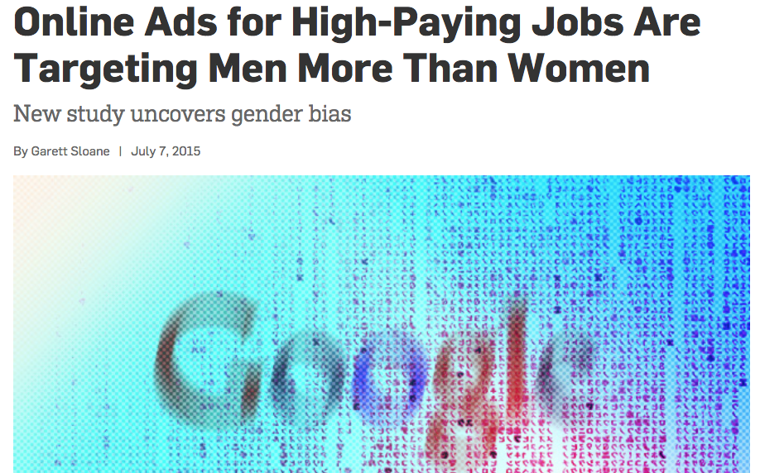
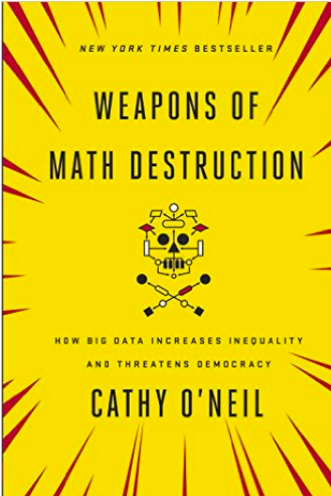
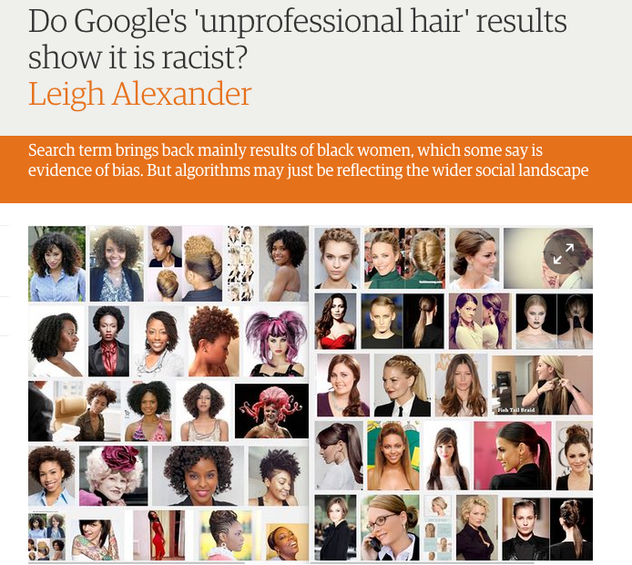
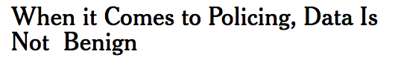
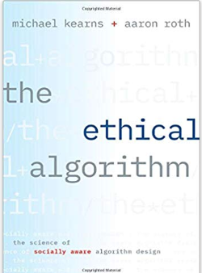
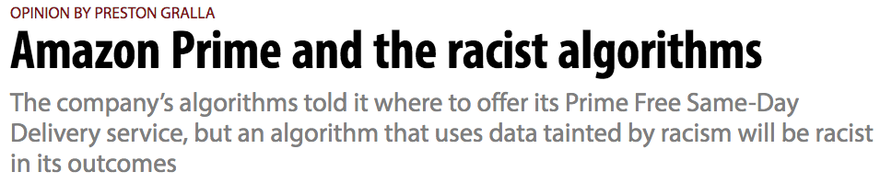

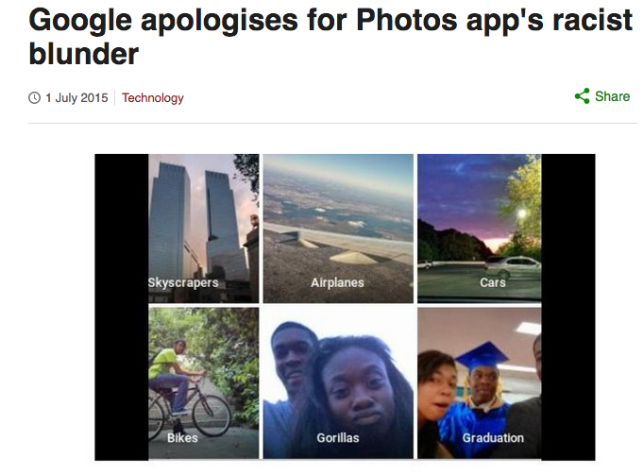
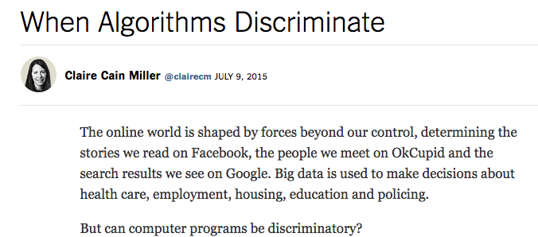
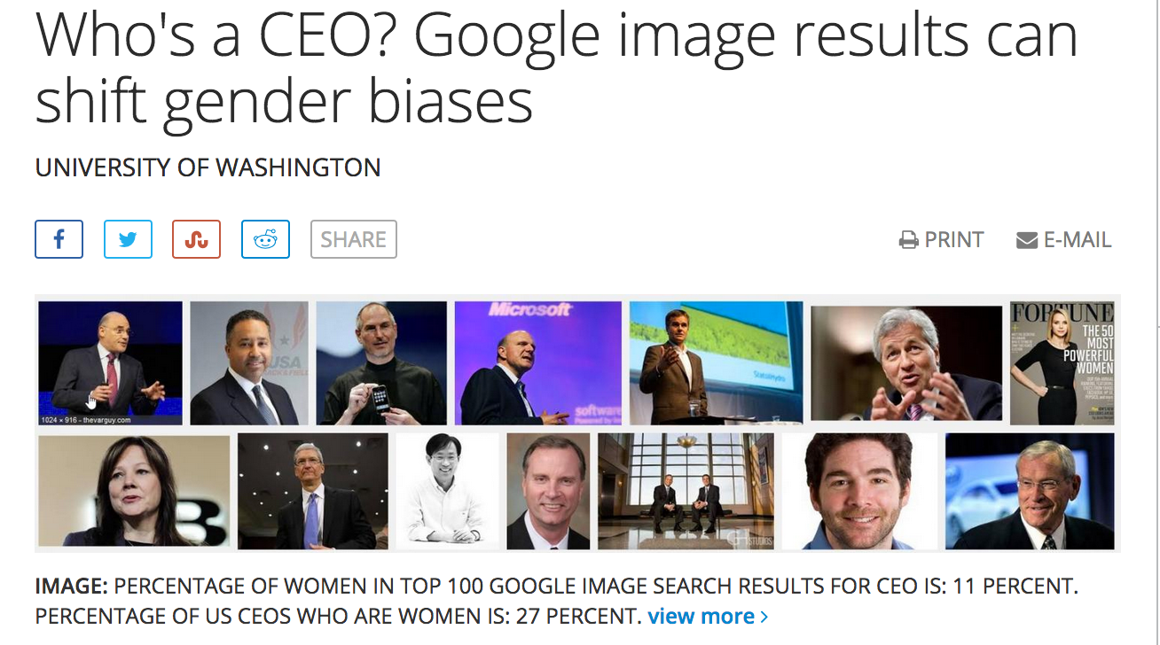
Slide content courtesy of Hanna Wallach
Notes:
There are many news stories and books about ethics and Data Science. Although there are more problems than there are solutions, there are also lots of new, interesting research directions that are being pursued by data scientists, which we will point to throughout this module.
This module is a intended as a short introduction. There is an excelled edX course on this topic that we recommend – and we also give pointers to other resources throughout the speaker notes.

Slide 4
A good data scientist needs to understand the ethical issues surrounding the data they obtain/use, the algorithms they employ, and its impact on people.
Notes:
This is the starting point

Slide 5
What we’ll discuss…
What do we mean by “ethics”?
Ethics surrounding data
Privacy and informed consent
Ownership and intellectual property
Ethics surrounding models / algorithms
Biased algorithms
Bad results from good data
Fairness
Reproducibility

Slide 6
Why do People do the Right Thing?
Morality (ethics)
Rules/duty (deontological) vs.
Outcomes (consequentialism) vs.
Subjectivism vs.
Virtue ethics vs. …
Laws and legal / criminal liability
Fear of non-legal consequences
Notes:
What are ethics? Ethics are rules that we all voluntarily follow because it makes the world a better place for all of us. They are the cornerstone of civilization.
Ethical principles stop me from stealing your car. Laws also stop me from stealing your car, since I could get caught and put in jail. Non-legal consequences are also a factor: I might be unsuccessful and you would beat me up.
But ethics go beyond laws. If you tell me a secret and I agree not to tell it but do, it is not a crime. However, it might damage my reputation with others, or I could lose your friendship. Again, non-legal consequences might be a factor.

Slide 7
Part of the Problem: What Is the Right Thing?
Sometimes it becomes evident only in retrospect
E.g. a naïve action led to bad consequences
But such experiences and consequences are what shape our understanding for the future, our policies, and our laws
E.g. many rules regarding data ethics are highly influenced by medicine (human subjects)
Notes:
When ethics are not laws, laws often follow ethics because ethics are our shared social values. Laws are often created to enforce these shared social values. For example, when spam mail first arose it might have seemed like a good idea, but after time it became clear that it was not – and laws have been put in place to govern them, e.g. the CAN-SPAM Act.

Slide 8
Ethics Surrounding Data

Slide 9
Ethical Principles around Data
Autonomy
The right to control your data, possibly via surrogates
Informed consent
You should explicitly approve use of your data based on understanding
Beneficence
People using your data should do it for your benefit
Non-maleficence
Do no harm
Notes:
Much of the ethical use of data is shaped by human subject research.

Slide 10

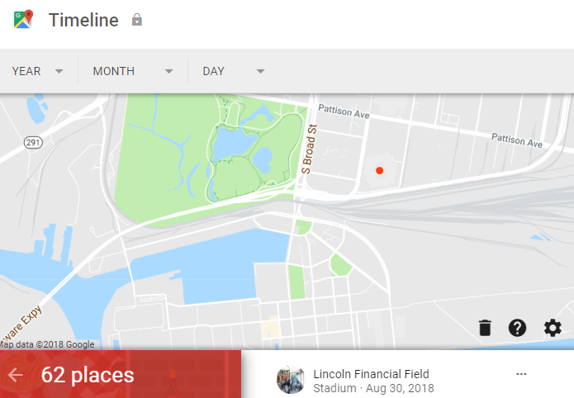
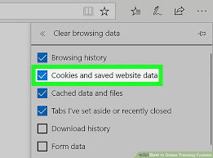
Data Collection
Data is constantly being collected about us!
Cameras
Cell phone location reporting
Accelerometers
Social media
Click-throughs, cookies
Do I own data collected about me?
What if I don’t like what the data says about me?
Can I control how the data is used?
Notes:
There is a lot of recent discussion around the ethics of how data is collected, whether we “own” it, and can control how it can be deleted. For example, the EU’s data protection law (GDPR) gives individuals the right to ask organizations to delete their personal data.

Slide 11
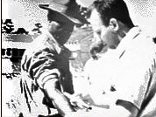
Data and Informed Consent
In human subjects research, there is a notion of informed consent
Must understand what is being done
Must voluntarily consent to the experiment
Must have the right to withdraw consent at any time
Not required in “ordinary conduct of business”
E.g. A/B testing is allowed, and is used all the time on Facebook
But this is a very fine line…
Notes:
What are the implications for of data and informed consent for organizations such as Facebook, Google, ….? We’ll look at some examples next which can serve as the basis for discussion.

Slide 12
Facebook’s Mood Manipulation Experiment
In 2012 researchers at Facebook and Cornell University manipulated the newsfeed of selected Facebook users.
Some users were shown more positive articles.
Others were shown more negative or sad articles.
People who were shown more positive articles posted more positive articles themselves on Facebook
People who were shown shown more negative articles posted more negative articles.
i.e., they demonstrated “emotional contagion”
Proc. of the National Academies of Science (2014): “Experimental Evidence of Massive-Scale Emotional Contagion Through Social Networks”

Slide 13
Was this Legal?
Facebook’s terms of service: users relinquish the use of their data for “data analysis, testing, [and] research.”
Facebook statement: “This research was conducted for a single week in 2012 and none of the data used was associated with a specific person’s Facebook account. We do research to improve our services and to make the content people see on Facebook as relevant and engaging as possible. A big part of this is understanding how people respond to different types of content, whether it’s positive or negative in tone, news from friends, or information from pages they follow. We carefully consider what research we do and have a strong internal review process. There is no unnecessary collection of people’s data in connection with these research initiatives and all data is stored securely.”
Notes:
Facebook didn’t ask anyone if they wanted to be part of the study.

Slide 14
Was this Ethical?
“And at the end of the day, the actual impact on people in the experiment was the minimal amount to statistically detect it,”
“Having written and designed this experiment myself, I can tell you that our goal was never to upset anyone. […] In hindsight, the research benefits of the paper may not have justified all of this anxiety.”
Adam D.I. Kramer, Facebook social psychologist
Notes:
https://i.ytimg.com/vi/yKjIGL3dfcA/maxresdefault.jpg

Slide 15
Data Science and Informed Consent
Informed consent is often buried in the fine print
Data is often collected first; the experiment comes later
How the data, once collected, is going to be used is difficult to control
Most people ignore the terms of usage and just click through!
Notes:
There are several issues with informed consent with data. Firstly, the terms of consent are frequently difficult to understand and buried in fine print. Most of us ignore the terms of usage and just click through. Second, it is difficult to control how data, once collected, could be used in the future. It is difficult to keep track of how it is copied and reused.

Slide 16
OKCupid Experiments with Customers
“Love Is Blind Day”
Suppressed photographs in user profiles so customer could not see profile photographs of potential people to meet
Customers could still read what was written in profiles, e.g. interests
Effect: people had longer conversations until photos restored!
Other experiments:
Took people with low compatibility score, told them it was high
Took people with high compatibility score, told them it was low
Three by three test matrix: 30, 60 and 90% compatibility score actual versus 30, 60, and 90% declared
OKCupid Plays With Love in User Experiments, Molly Wood, NY Times, July 28, 2014
Notes:
People felt that they were being deceived.

Slide 17
Was this Legal? Ethical?
CEO (through 2015) Christian Rudder: “But guess what, everybody: if you use the Internet, you’re the subject of hundreds of experiments at any given time, on every site. That’s how websites work.”
Indeed Google changes rankings, Facebook A/B tests user functionality and recommendations, etc.
On the other hand, having a company intentionally lie to you, intentionally give you a wrong score, is something that many people consider socially unacceptable.

Slide 18
Intellectual Property
Patents only protect implementations, not ideas
Artistic expression can be copyrighted: exclusive legal right to print, publish, perform, film or record and authorize others to do the same
Derivative work can be created with permission
There’s also a notion of citation, in which we give credit to the owner
What about data?
Wikipedia, Yelp, Rotten Tomatoes, TripAdvisor
A clinical data set, a company’s data, your gene sequence, …
What does it reveal about people?
Notes:
Big data sets are very vague about how they are protected.

Slide 19
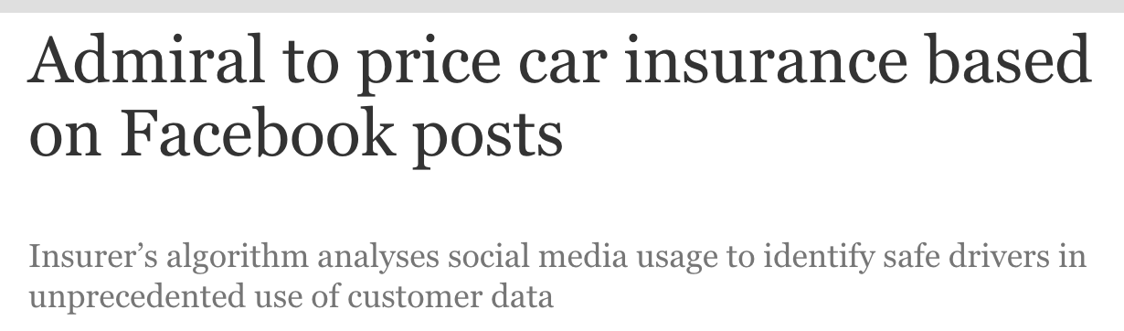

Notes:
There are lots of cases where your data influences what services you get. Your insurance company may put a GPS tracker on your car and give you different rates depending on whether you are speeding or other driving habits. Companies may also look at data on your Facebook page.

Slide 20
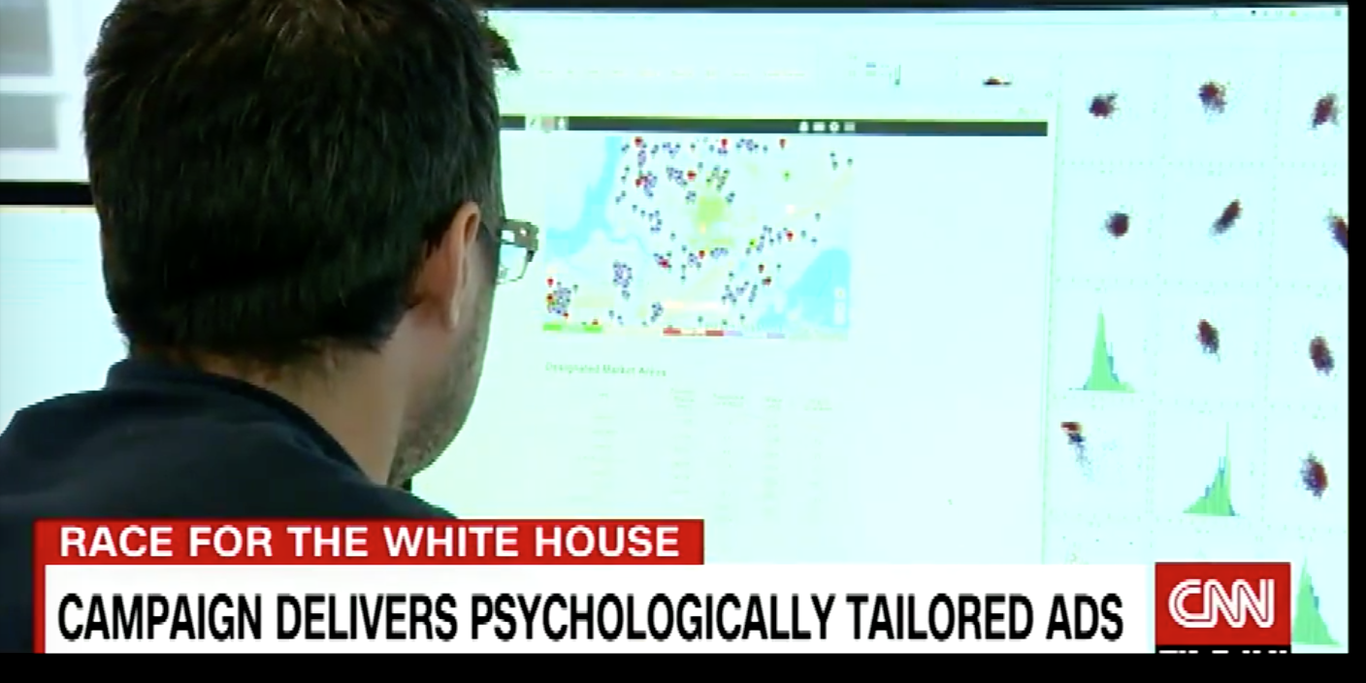
Targeted marketing: Cambridge Analytica
Notes:
As another example, Cambridge Analytica claimed to have won the White House for Donald Trump by using Google, Snapchat, Twitter, Facebook and YouTube. Intensive survey research, data modelling and performance-optimising algorithms were used to target 10,000 different ads to different audiences in the months leading up to the election. The ads were viewed billions of times, according to the presentation.
https://www.theguardian.com/uk-news/2018/mar/23/leaked-cambridge-analyticas-blueprint-for-trump-victory

Slide 21
Privacy
Notes:
Privacy is a basic human need
Privacy is not black and white – it is an exercise of control
Loss of privacy occurs when there’s a loss of control over personal data

Slide 22
OKCupid Data Publicly Released
WIRED, Michael Zimmer 5/14/16
May 8, 2016: Danish researchers publicly released a dataset of ~70,000 OKcupid users
Usernames, age, gender, location, what kind of relationship they are interested in
Personality traits, answers to 1000s of profiling questions
Did they attempt to anonymize?
Researcher’s response: “… all the data found in the dataset are or were already publicly available, so releasing this dataset merely presents it in a more useful form.”

Slide 23
Was the OKCupid Data “Public”?
Data acquired by screen scraping – methodology not fully explained
Likely from an OkCupid profile researchers created!
OkCupid users may restrict the visibility of their profiles to logged-in users only
Likely that the researchers collected—and released—profiles that were intended to not be publicly viewable

Slide 24
Privacy is not Simple
Many rules governing use of collected information
HIPAA: Health Insurance Portability and Accountability Act
FERPA: Family Educational Rights and Privacy Act
GDPR General Data Protection Regulation (Europe)
However, “information leakage” can lead to unexpected disclosures
E.g. smart water meters
“Privacy by trust” versus “privacy by design”
Notes:
https://takebackyourpower.net/comprehensive-report-how-smart-meters-invade-privacy/

Slide 25
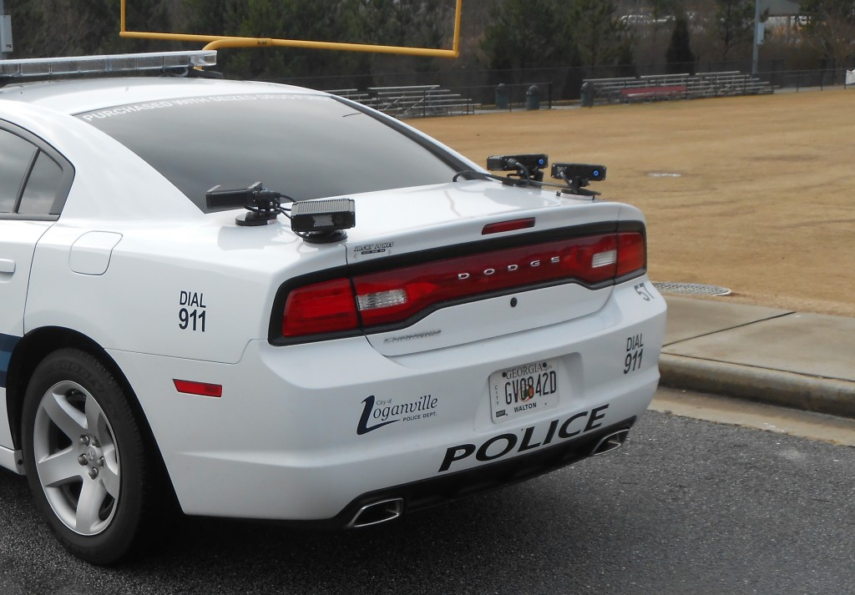
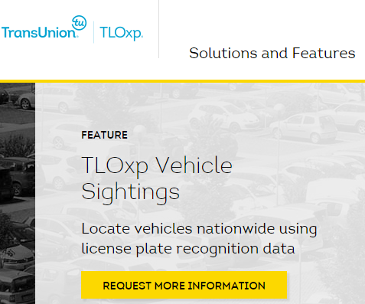
Another Example: License Plate Readers
Notes:
Cities are increasingly using automated license plate reader (ALPR) technology. Camera systems are ubiquitous at mails, train stations; and airports they appear at intersections and on the dashboards of police cars. This information can be used to create a very detailed picture of a driver’s whereabouts over time. Much of this information is not important for fighting crime. Apart from the loss of privacy to individuals, the information could be used for many different, bad, reasons.
.

Slide 26
De-Identification: AOL user No. 4417749
Is removing identifiable information from data (e.g. name, phone, address…) sufficient to protect the identity of individuals?
AOL user No. 4417749: identified as Thelma Arnold based on search history
“Landscapers in Lilburn, Ga”, several people with the last name Arnold, “homes sold in shadow lake subdivision gwinnett county georgia”
Notes:
Even if an “identifier” such as a license plate number is not involved, there are questions about how and whether collected data can be used to identify individuals. Some examples…

Slide 27
De-Identification: General Insurance Commission
Is removing identifiable information from data (e.g. name, phone, address…) sufficient to protect the identity of individuals?
Massachusetts re-identification incident: The General Insurance Commission released de-identified health records.
Latanya Sweeney used ZIP code, birth date, and sex to locate the health record of then-Governor William Weld.
She was able to look up his diagnoses and prescriptions.
This event was pivotal in revisions to the HIPAA Privacy Rule to restrict disclosure of full birthdate and zip codes under the Safe Harbor standards.

Slide 28
Correlating data
Netflix Prize Competition: released a de-identified data set with user ID, date, movie name, and the rating given by the user for that movie.
Researchers were able to link users with IMDb's system where the users were identified, and talked about (some of) the movies they watched.
Problem: “Sparsity” of data
In Netflix data, no two profiles are more than 50% similar.
If a Netflix profile is more than 50% similar to a profile in IMDB, then there is a high probability that the two profiles are of the same person
A. Narayanan and V. Shmatikov, “Robust de-anonymization of large sparse datasets …,” Proc. 29th IEEE Symp. Security and Privacy, 2008.

Slide 29
Differential Privacy
When do you feel safe releasing personal information, e.g. completing a survey about your tastes in movies?
My answers have no impact on the privatized released result?
With high probability, an attacker looking at the privatized released result cannot learn any new information about me?
These are not achievable.
Differential privacy aims to maximize the accuracy of queries from statistical databases while minimizing the chances of identifying its records – it adds noise and provides guarantees against a “privacy budget”.
The privatized released result is nearly the same whether or not I submit my information.
Dwork and Roth, “Algorithmic Foundations of Differential Privacy,” Foundations and Trends in Theoretical Computer Science (2014).
Notes:
The question of how and whether data you release is “safe”, i.e. whether or not you can be identified using the released data, is a topic that has been well studied in the computer science community. One notion that has been formalized is ”differential privacy”, whose goal is to provide as much statisital information as possible from data stored in database while guaranteeing that an individual cannot be identified.
Differential privacy ensures, for example, that a person can contribute their genetic information to a medical database without fear that anyone analyzing the database will be able to figure out which genetic information is hers — or even whether she has participated in the database at all. And it achieves this security guarantee in a way that allows researchers to use the database to make new discoveries.
Ideas from this research are now finding their way into practice, e.g. the US Census Bureau (2008, commuting patterns), Google (2015, historical traffic statistics), among others.

Slide 30
Ethics Surrounding Algorithms

Slide 31
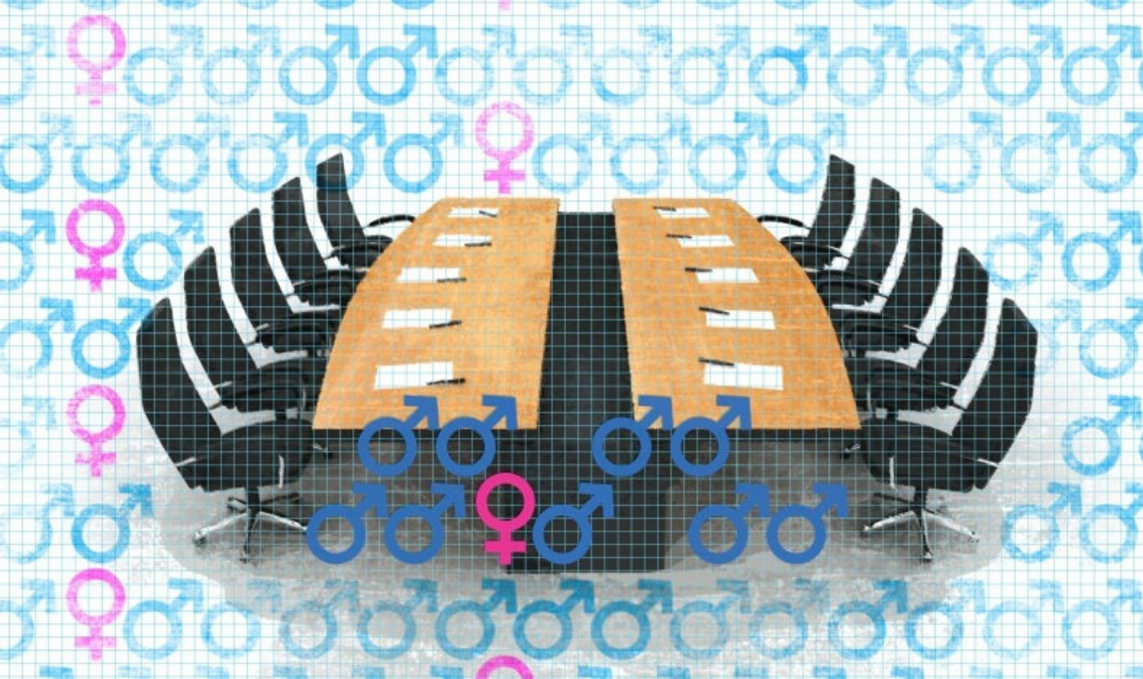
Algorithms are not neutral
Algorithms encode our biases.
Training data set isn’t representative
Past population is not representative of the future population
Overfitting to underrepresented data is common

Slide 32
How to get “bad” results from “good” data
Correlated attributes
Misleading results
p-hacking
Notes:
We’ll give some examples of these on the next slides.

Slide 33
Correlated attributes, example
Staples (the office supply store) decided to win business from their competitors by offering a lower price online to customers living near one of their competitors.
Seems fine, right?
However, OfficeMax stores happen to be located in higher income areas, not in rural areas or poor neighborhoods.
So if you live in a poorer neighborhood you ended up paying more than someone in a wealthier neighborhood.
Notes:
Staples was not intending to offer better prices to people in higher income areas, they were merely trying to compete with Office Max. But there was a correlation between income level and where Office Max stores are located.

Slide 34
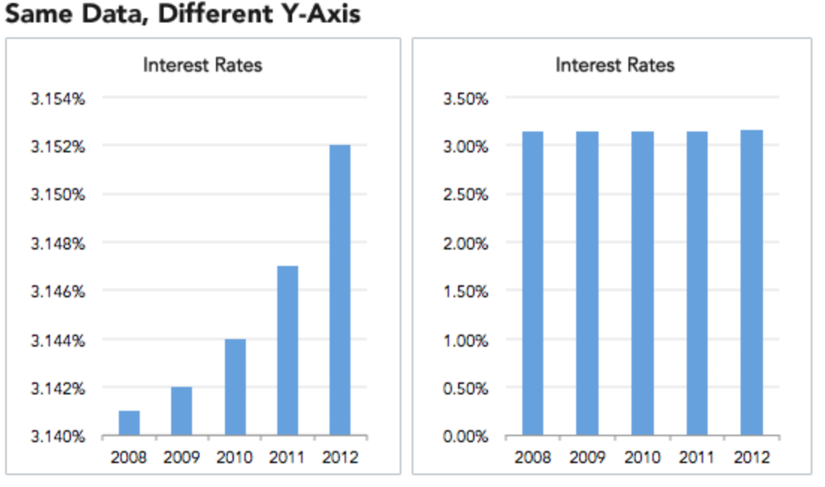
Misleading results 1
Notes:
Data can also be presented graphically that are misleading. In the bar chart to the left, it appears that there is a dramatic increase in interest rates from 2008 to 2012; however, if the y-axis is changed to start at 0, it is not so dramatic a change.

Slide 35
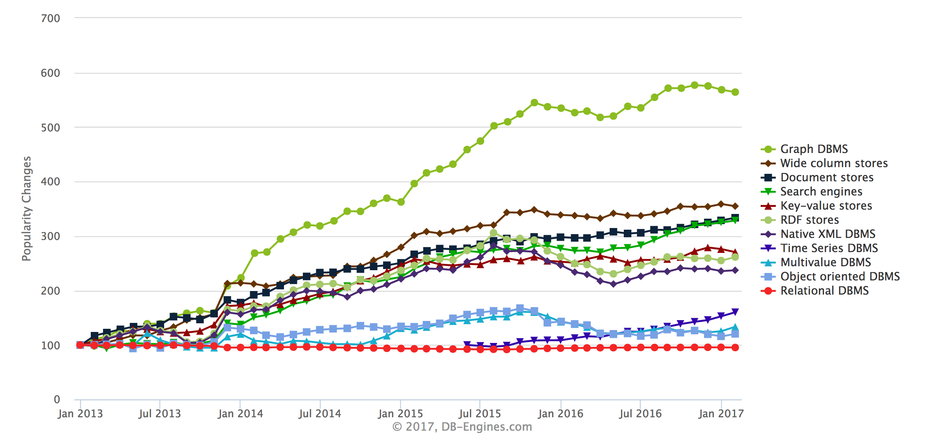
Misleading results 2
Notes:
As another example, in this figure the y-axis shows how different types of DBMS have changed in popularity, leading the viewer with the impression that graph DBMS are the “most popular”. However, relational DBMS (in red at the bottom) have been around a long time and are very popular. However, their popularity has not changed significantly over this time period, and they continue to command by far the largest market share of all these systems. Thje graphic is misleading since it leads you to believe that relational DBMS are “losing” with respect to NoSQL systems.

Slide 36
p-Hacking
Select which observations or features to include in the model
Try lots of different models
Report the best one as “significant”
Notes:
The p-value is used in the context of null hypothesis testing in order to quantify the statistical significance of evidence. In null hypothesis testing, a claim is assumed to be valid if its counter-claim is improbable.
P-hacking (aka data dredging, data fishing, data snooping, or data butchery) is a term coined in 2014 by Regina Nuzzo Nature. It is the misuse of data analytics to find patterns in data that can be presented as statistically significant, dramatically increasing and understating the risk of false positives. This is done by performing many statistical tests on the data and only reporting those that come back with significant results.

Slide 37
Emerging Area: FAT* (Fairness, Accountability, Transparency)
Fair decisions according to our notions of social justice
Ethical use of data
Interpretable decisions from machine learning
Notes:
Algorithmic systems contain inherent risks, such as codifying and entrenching biases; reducing accountability, and hindering due process.
Being able to quantify and reason about issues of fairness, accountability and transparency (which is related to reproducibility) has emerged as an important research area, as evidenced by books and conferences on the topic, e.g. the ACM Conference on Fairness, Accountability, and Transparency (ACM FAccT). This conference brings together a diverse community of researchers from computer science, law, social sciences, and humanities to investigate and tackle issues in FAT*. Another good resource for learning more about this in depth is https://geomblog.github.io/fairness.
In the next few slides, we will give some examples of issues in FAT*.

Slide 38
Fairness
Fairness has been studied in social choice theory, game theory, economics and law.
Currently trendy in theoretical computer science
Discrimination of an individual: An individual from the target group gets treated differently from an otherwise identical individual not from the target group.
Discrimination in aggregate outcome: the percentage success of the target group compared to that of the general population.
Dwork, Hardt, Pitassi, Reingold and Zemel,
“Fairness through Awareness”
Proc. 3rd Innovations in Theoretical Computer Science, 2012.
Notes:
It is important that algorithms be “fair”, e.g. classify people in ways that are consistent with commonsense notions of fairness. For example, we wouldn’t think it’s ethical for a bank to offer one set of lending terms to minority applicants and another to white applicants. But as recent work has shown — most notably in the book “Weapons of Math Destruction” by the mathematician Cathy O’Neil — discrimination that we reject in normal life can creep into algorithms.
Suppose you had a minority group in which the smart students were steered toward math and science, and a dominant group in which the smart students were steered toward finance. Now if someone wanted to write a quick-and-dirty classifier to find smart students, they might look for students who study finance because the majority is much bigger than the minority. The problem is that not only is this unfair to the minority, but it also has reduced utility compared to a classifier that understands that if you’re a member of the minority and you study math, you should be viewed as similar to a member of the majority who studies finance.
Individual fairness is also not enough to ensure group fairness. For example, suppose you are looking at college admissions and you’re thinking about using test scores as your admission criterion. If you have two groups that have very different performance on standardized tests, then you won’t get group fairness if you have one threshold for the standardized-test score.
For a lengthier discussion, see the book The Ethical Algorithm: The Science of Socially Aware Algorithm Design by Michael Kearns and Aaron Roth. Another great resource is an interview with Cynthia Dwork, https://www.quantamagazine.org/making-algorithms-fair-an-interview-with-cynthia-dwork-20161123.

Slide 39

Why is computer advice on parole controversial?
https://www.propublica.org/article/machine-bias-risk-assessments-in-criminal-sentencing
Notes:
Another example of lack of algorithmic fairness are the algorithms frequently used in sentencing and parole, which generate a score predicting the likelihood of an individual committing a future crime.
However, it is not clear the the algorithms used are predictive, and they seem to show racial disparities.
‘For example, Propublica obtained the risk scores assigned by one such algorithm to more than 7,000 people arrested in Broward County, Florida, in 2013 and 2014 and checked to see how many were charged with new crimes over the next two years. They found that the score proved remarkably unreliable in forecasting violent crime: Only 20 percent of the people predicted to commit violent crimes actually went on to do so. When a full range of crimes were taken into account — including misdemeanors such as driving with an expired license — the algorithm was only somewhat more accurate than a coin flip.
They also discovered significant racial disparities: In forecasting who would re-offend, the algorithm made mistakes with black and white defendants at roughly the same rate but in very different ways. The formula was particularly likely to falsely flag black defendants as future criminals, wrongly labeling them this way at almost twice the rate as white defendants. White defendants were mislabeled as low risk more often than black defendants.

Slide 40
Reproducibility
We need to be able to reproduce results but …
The algorithms used in data science are complicated
When things “go wrong”, we need to understand why
Research code is often shared; commercial algorithms less so
The data often cannot be shared
Notes:
Generally speaking, “transparency” means that data as well as information describing data collection methods, raw data and research analyses should be made available. This enables the “reproducibility” of research results.
However, this is hard to achieve since the algorithms (in particular, ML algorithms) are frequently complicated and it is often difficult to understand the dependencies between data and code. Furthermore when the algorithms may be “black boxes”, making it impossible to open them up to reason about results. Furthermore, there may be privacy issues associated with the data and it cannot be shared.

Slide 41
Facilitating Reproducibility
To facilitate reproducibility, the “FAIR” principles have been proposed:
Findable
Accessible
Interoperable
Reusable
Techniques: versioning (git), provenance tracking (data derivation history), workflow systems, metadata capture, open standards
https://www.nature.com/articles/sdata201618
Notes:
The FAIR Data Principles were proposed as guideline for those wishing to enhance the transparency of their data and research results. As opposed to other initiatives that focus on the human side of things, these principles put specific emphasis on enhancing the ability of machines to automatically find and use the data, in addition to supporting its reuse by individuals.
https://www.nature.com/articles/sdata201618
There is a lot of ongoing research in how to facilitate reproducibility especially with respect to provenance – understanding the “why” and “where” of data. Examples include providing provenance tracking environments for different execution environments (e.g. Jupyter notebooks or R-markdown source documents) and understanding provenance through machine learning operations.

Slide 42
Ethics summary
Codes of conduct for research are fairly well understood
Get IRB approval
Obtain informed consent
Protect the privacy of subjects
Maintain the confidentiality of data collected, minimize harm
Fairness is more subtle
What is fair treatment of a group: equal accuracy? False-positive rate?
Key technical aspects:
Differential privacy (bounds amount of information revealed)
Data provenance
Trade-off between optimizing outcomes vs avoiding discrimination against a group

